Slide 1

Capstone Project – Football Analysis
Name : Saravanan S (EN12025087383)
Program: NIIT – Data Science and ML with GEN AI
Mentor : Mr. Munna Pandey
Batch : DA47

Slide 2

Introduction
This project analyzes football match data using Python, SQL, Tableau, and Excel.
Python used for Data Preprocessing, merging, ML Analysis
SQL queries are used to extract insights on referees, teams, players, goals, and match outcomes.
Results are exported to Excel for structured reporting.
Tableau dashboards provide interactive visualizations for deeper analysis.
Aim: Demonstrate skills in data extraction, visualization, and deriving actionable business insights

Slide 3

Dataset Overview & Objectives
Data Overview
Dataset contains football match records with details such as:
Clubs (home & away)
Players, referees, and match officials
Goals scored (home vs away)
Match outcomes (win/loss/draw)
Cleaned and structured data stored in SQL tables.
Objectives
Extract key performance insights using SQL queries.
Identify referee bias, team strengths, and scoring trends.
Summarize results in Excel dashboards for easy interpretation.
Provide actionable findings for sports analytics and decision-making.

Slide 4

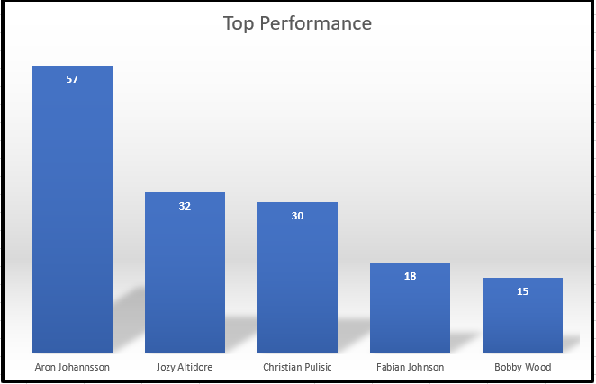
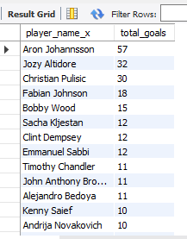
Top Performance
Aron Johannsson leads by a huge margin with 57 goals, establishing himself as the team’s key striker and most consistent finisher.
Jozy Altidore (32 goals) and Christian Pulisic (30 goals) form the strong supporting core, showing solid attacking impact.
Fabian Johnson (18) and Bobby Wood (15) contribute important goals, ensuring depth in the squad’s offensive capability.
Insight: While Aron Johannsson is the clear star, the gap suggests a need for broader goal distribution to reduce dependency on a single player.

Slide 5
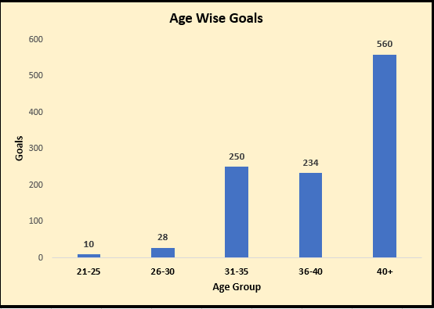
Age Wise Performance
Young players (21–25 years) contributed 10 goals, while mid-career players (26–30 years) scored 28 goals.
Peak goal scoring happens between 31–40 years, with 250 goals (31–35) and 234 goals (36–40).
Surprisingly, players aged 40+ scored 560 goals, highlighting the strong contribution of senior/experienced players, possibly due to tactical play, positioning, and leadership on field.

Slide 6

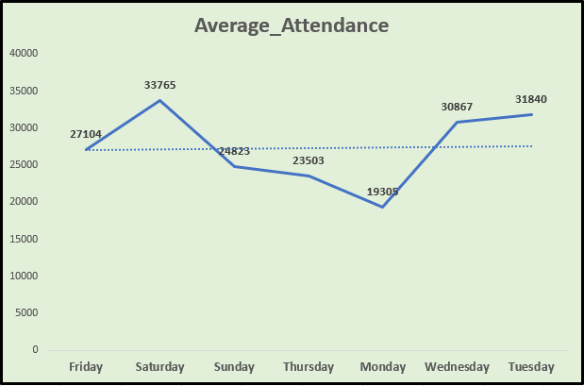
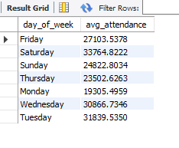
Audience Analysis
Saturday matches attract the highest average crowd (33,765 spectators), followed by Tuesday (31,840) and Wednesday (30,867).
Friday and Sunday maintain moderate numbers (27,104 and 24,823 respectively).
Monday matches see the lowest attendance (19,305), likely due to weekday commitments.
Insights: Scheduling high-profile matches on weekends or mid-week may maximize fan turnout.

Slide 7
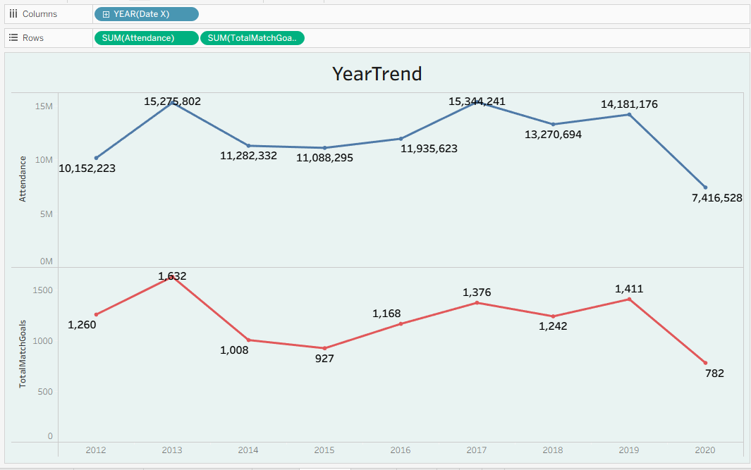
Year wise Goals & Attendance
From 2012 to 2019, both stadium attendance and goals scored followed fluctuating but noticeable cycles — with 2013 and 2017 standing out as peak years, showing record fan engagement (15M+) and high goal outputs (1,632 in 2013, 1,376 in 2017). The mid-phase (2014–2015) saw dips in both attendance (11M) and goals (927–1,008), indicating quieter seasons. Recovery was evident in 2016–2019, where attendance stabilized around 13–14M and goals ranged from 1,168 to 1,411, reflecting stronger competition. In 2020 (till September), the data already shows 7.4M attendees and 782 goals, suggesting that even in a partial season, engagement and scoring remained resilient.

Slide 8
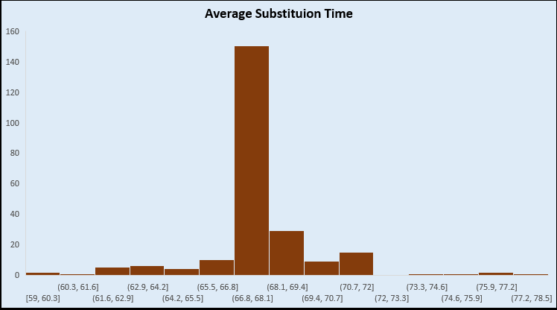
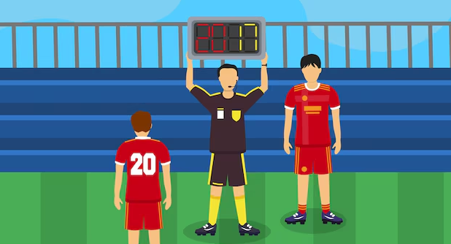
Substitution Analysis
The peak substitution period is between 66.8 to 68.1 minutes, indicating that coaches often prefer to adjust tactics in the second half, soon after the 65th minute mark.
This window is significantly higher compared to other substitution timings, reflecting strategic changes for energy boost, defensive tightening, or game-changing moves.

Slide 9

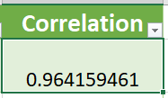
Referee Influence on Home Wins
Home Wins & Total Matches
There is a very strong correlation (r = 0.964) between the number of home wins and total matches refereed, indicating referee assignments strongly align with home performance outcomes.
Referees who officiate more matches tend to show proportionally higher home wins, which is logical: more matches = more opportunities for wins.
Example: Marco Fritz (76 home wins in 142 matches) and Daniel Siebert (58 in 126 matches) are consistent with the trend.
Top referees like Manuel Grafe (64 in 132), Kevin Friend (56 in 116), Jonathan Moss (50 in 92) all fall on the line of correlation.
This 0.964 correlation coefficient is extremely close to +1, meaning the relationship is almost linear — as total matches increase, home wins rise at a predictable rate.

Slide 10
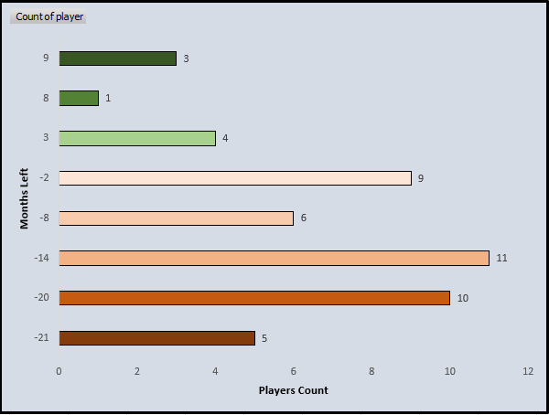
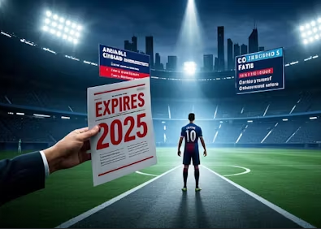
Player Contract Time
. Short-term expiries dominate:
–2 to –21 months cover most players (41 players), signaling many already past or at risk of contract expiry.
Specifically, 11 players with –14 months and 10 players with –20 months need urgent attention.
Few players with ongoing contracts:
3 to 9 months left for only 8 players, and just 1 player has 8 months left.
Insights: The club needs immediate renewal/transfer strategies, as a large share of the squad is contract-critical.

Slide 11
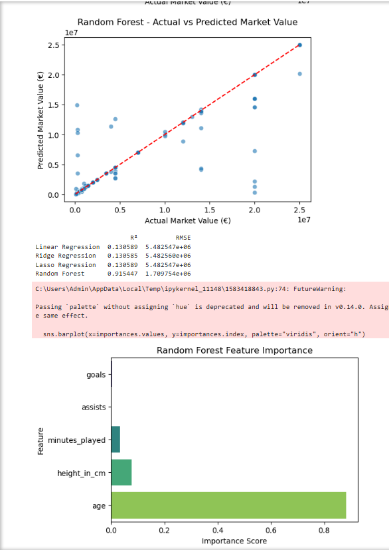
Player Market Value
1. Linear, Ridge, Lasso
All three linear-based models gave R² ≈ 0.43 and RMSE ≈ €6.2M.
Interpretation: These models explain less than half of the variance in player market value, meaning they are too simplistic. Ridge and Lasso didn’t improve much since the dataset likely doesn’t have multicollinearity or redundant features that require heavy regularization.
2. Random Forest
R² ≈ 0.92 and RMSE ≈ €2.34M.
This shows a massive improvement — the model explains ~92% of the variance and reduces prediction error by ~60% compared to linear models.
Interpretation: Market value has nonlinear relationships (e.g., goals scored matters a lot at young ages, but differently at older ages). Tree-based methods like Random Forest can capture these patterns.

Slide 12

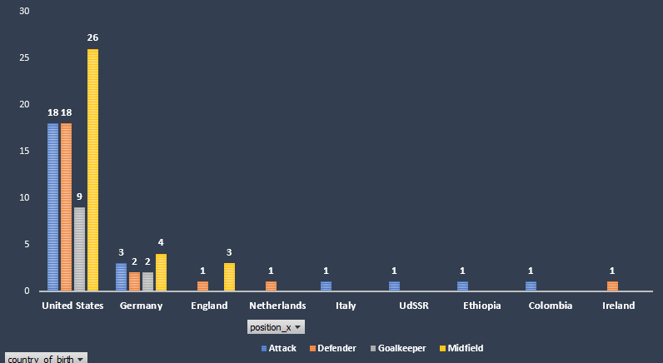
Nationality & Positions
The dataset highlights how players are distributed by nationality and playing position. A striking observation is that the United States dominates the squad composition, with the highest representation across all positions — 26 midfielders, 18 defenders, 18 attackers, and 9 goalkeepers. This suggests a broad and balanced contribution of U.S. players to the team’s depth.
In contrast, players from European nations like Germany (12 total: 4 midfield, 3 attackers, 2 defenders, 2 goalkeepers) and England (4 total: 3 midfield, 1 defender) have a smaller but notable presence, mainly concentrated in midfield and attack roles. Other countries such as Colombia, Italy, Ireland, Netherlands, Ethiopia, and UdSSR each contribute a single player, indicating they serve more as unique additions rather than forming a core.
Overall, the analysis shows that while the team is internationally diverse, it is heavily anchored by U.S. talent across every position, with Germany being the next strongest contributor in terms of balanced positional spread.

Slide 13
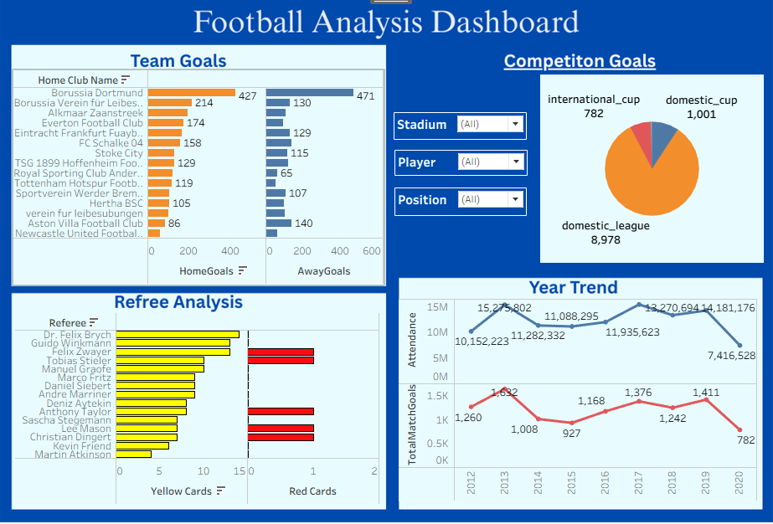
Analysis Dashboard
In Domestic Leagues, Scoring many goals as many matches are conducted when compared to International games
2013 is huge year , many peoples watched as a person , many goals in that particular year
Many Clubs score goals in home match as they are familiar with ground when compared to away grounds

Slide 14

Business Insights
Reduce reliance on aging players by investing in scouting and academies
Expand scouting to Europe/Latin America for competitive edge
Focus on Saturday + mid-week prime slots for maximum revenue.
Market top players (Johannsson, Pulisic) while developing backup scorers
Renew or offload expiring players quickly to avoid free losses
Leverage U.S. dominance for local fan campaigns, diversify for international fanbase.
Use Random Forest model for accurate player valuations
Boost digital presence and fan experiences to regain pre-2020 attendance levels.

Slide 15
THANK YOU
“
”
Saravanan S

